Slide 1
Underground Railroad Stations

Slide 2
Moncure Conway House Falmouth, Virginia
In this house, Moncure Conway housed 30 slaves and helped them escape to freedom.

Slide 3
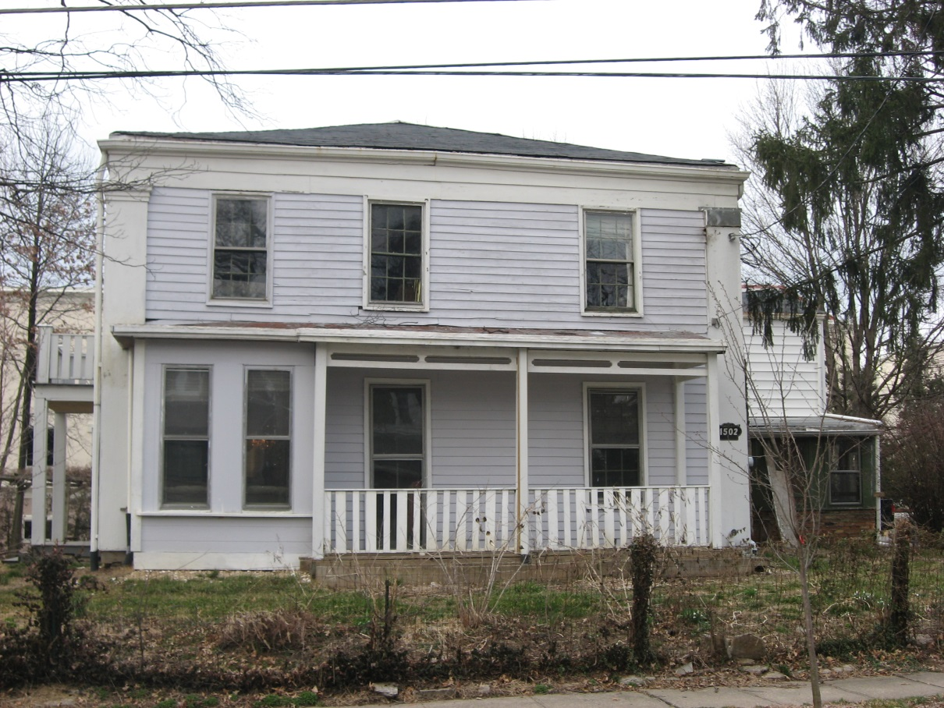
Samuel and Sally Wilson House Cincinnati, Ohio
The house of Samuel and Sally Wilson, who were strong abolitionists, was an important stop on the Underground Railroad.

Slide 4
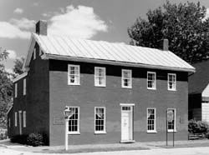
Levi Coffin House Fountain City, Indiana
Levi Coffin is known as the president of the Underground Railroad because of the large amount of slaves he helped to freedom. His house was a “principal depot”.

Slide 5
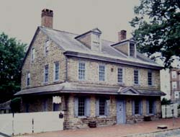
Johnson House Philadelphia, Pennsylvania
The Johnson House was a key site in the movement to end slavery and a very well-known house on the escape to freedom.

Slide 6
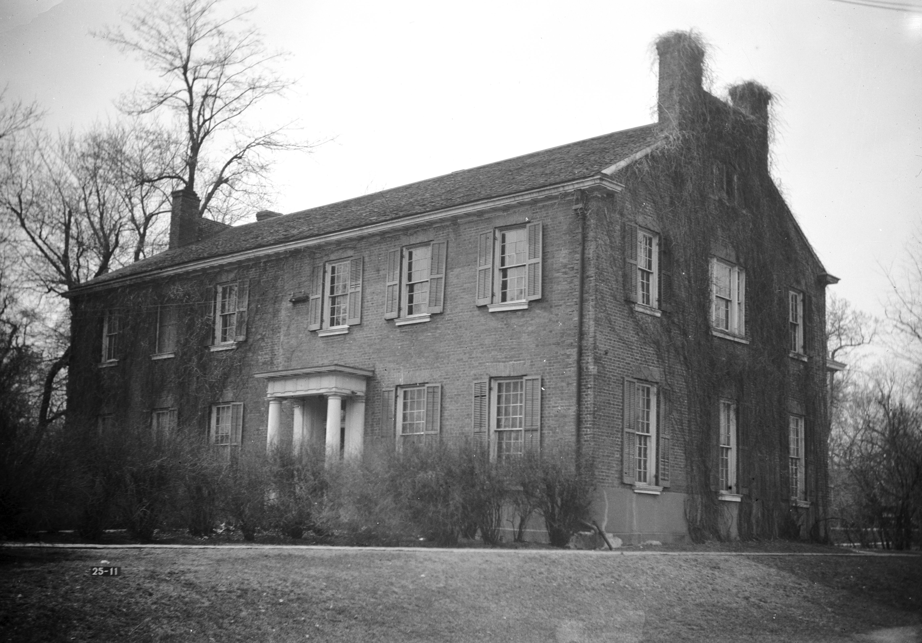
Beecher Hall Jacksonville, Illinois
Beecher Hall is the original building of Illinois College. Slaves were able to hide in the classrooms and residential areas.

Slide 7
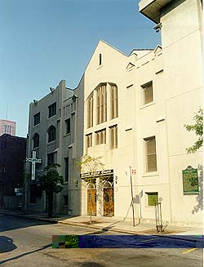
Second Baptist Church Detroit, Michigan
This church help Michigan’s first African American congregation. Soon after, it became apart of the Underground Railroad because of it’s close proximity to Canada.

Slide 8
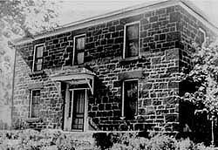
George B. Hitchcock House Lewis, Iowa
Hitchcock was very active in the abolitionists movement and offered his house to any escaping slave or abolitionist.

Slide 9
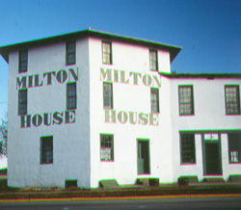
Milton House Milton, Wisconsin
This house on the Underground Railroad was built by conductor Joseph Goodrich.

Slide 10
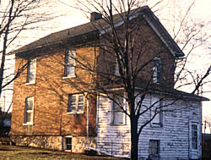
Harriet Tubman Home of the Aged Auburn, New York
Harriet Tubman is one of the most famous conductors of the Underground Railroad. Once she gained freedom herself, she returned back to slave states to help other slaves escape. She offered up her home to those escaping.

Slide 11
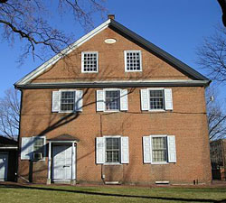
Friends Meeting House Wilmington, Delaware
Members who attended this Meeting House were very active in the Underground Railroad making it a very resourceful place for slaves to hide.

Slide 12
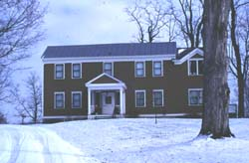
Rokeby Ferrisburgh, Vermont
The four generations of family members that lived in this house wrote in journals and diaries that tell of the mass amount of Underground Railroad activity that occurred in this house.

Slide 13
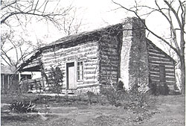
John Brown Cabin Osawatomie, Kansas
John Brown’s cabin, one of his many properties, was occasionally a head quarters for abolitionist activity.

